Slide 1

Value of Firm
Ranjith N (32818119)
Aravind C (32818116)
Guide: Prof. Ram Chakravarthi

Slide 2
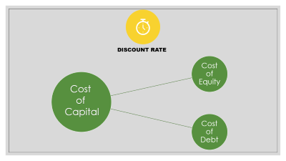
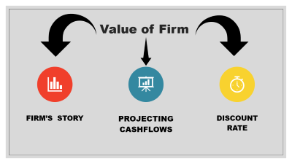
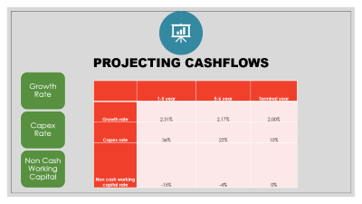
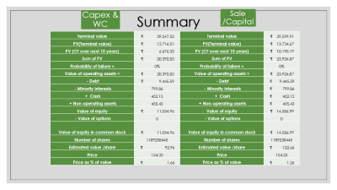
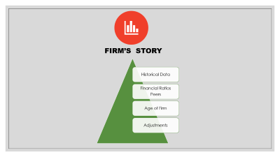

Slide 3



Value of Firm
Firm’s Story
Projecting Cashflows
Discount rate

Slide 4
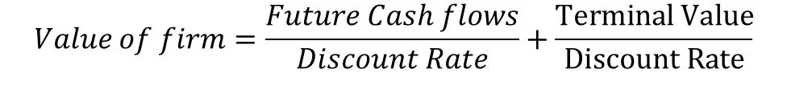
Value of firm
$$Value of firm=\frac{Future Cash flows}{Discount Rate}+\frac{Terminal Value}{Discount Rate}$$

Slide 5

Firm’s Story
Historical Data
Financial Ratios
Peers
Age of Firm
Adjustments

Slide 6
Firm Story
Historical Data
 | 2015 | 2016 | 2017 | 2018 | 2019
Net Sales | 4188.64 | 4590.92 | 4010.26 | 4103.55 | 4512
COGS | 443.09 | 504.48 | 363.95 | 376.44 | 404.05
Operating Cost | 1462.46 | 1609.71 | 1364.65 | 1346.62 | 1470.79
Other Expenses | 1794.51 | 1860.15 | 1672.04 | 1710.14 | 1807.43
Other Income | 98.71 | 115.35 | 54.94 | 61.73 | 83.38
EBITDA | 587.29 | 731.93 | 664.56 | 732.08 | 913.11
Depreciation and amortisation | 291.29 | 316.67 | 299.37 | 301.2 | 327.85
EBIT before Exceptional Item | 296 | 415.26 | 365.19 | 430.88 | 585.26
Exceptional Item | -352.91 | 67.16 | 10.78 | -22.45 | -6.58
EBIT | 648.91 | 348.1 | 354.41 | 453.33 | 591.84
Interest Expense | 175.57 | 245.96 | 323.83 | 269.04 | 190.13
EBT | 473.34 | 102.14 | 30.58 | 184.29 | 401.71
Tax | 114.6 | 140.07 | 113.74 | 121.06 | 157.12
Net Profit | 358.74 | -37.93 | -83.16 | 63.23 | 244.59
Gross Profit | 3745.55 | 4086.44 | 3646.31 | 3727.11 | 4107.95

Slide 7
Firm Story
Financial Ratios
 | 2019 | IHCL | Industry AVG
PROFITABILITY | Gros Profit % | 4086.44 | 786.47 | S
 | Net Income % | 5.42% | 5.35% | N
 | Return on Equity | 4.75% | 6.73% | W
 | Return on Aseets | 2.55% | 2.49% | N
 | Asset Turnover | 47.08% | 44.50% | N
 | Operating Income Percentage | 13.12% | 13.71% | W
Solvency | Debt to Asset % | 24.27% | 20.19% | S
 | Interest Coverage Ratio | 3.112818 | 14.00 | W
Liquidity | Current Ratio | 0.55 | 0.91 | W
 | Quick Ratio | 0.51 | 0.75 | W
 | Accounts Receivable Turnover | 28.07891 | 28.79 | W
 | Account Receivable Days | 12.99908 | 52.06 | S
 | Inventory Turnover | 5 | 4.65 | N
 | Inventory Days | 73 | 236.45 | S
 | Trade Payable Turnover | 0.247194 | 0.96 | W
 | Trade Payable Days | 1476.57 | 351.96 | W

Slide 8
Firm Story
Age of Firm
Startup
Growth
Stable
Decline

Slide 9
Firm Story
Age of Firm
 | 2015 | 2016 | 2017 | 2018 | 2019
Operating Cash Margin | 535.1 | 709.52 | 681.16 | 737.85 | 936.92
Invested/Generated from Net working Assets | -20.6 | 46.93 | -59.86 | -103.31 | -28.23
Net Capital Expenditure | -311.13 | -398.62 | -393.96 | -504.94 | -460.39
Taxation | -19.73 | -97.38 | -86.79 | -142.49 | -197.26
CASH AVAILABLE TO SATISFY FINANCE PROVIDERS | 183.64 | 260.45 | 140.55 | -12.89 | 251.04
Net Interest | -129.96 | -126.9 | -137.54 | -383.06 | -132.92
Net Dividence | 7.74 | 12.04 | -29.42 | -28.65 | -46.37
Other Non-Operating Income/(Expenditure) | -487.9 | 587.82 | 1206.45 | -65.7 | 32.21
NET CASH GENERATED /(ABSOBED) BEFORE FINANCING | -426.48 | 733.41 | 1180.04 | -490.3 | 103.96
Financed by:
Increase /(Decrease) In Equity | 0 | 0 | 0 | 1499.88 | 22.42
Increase/(Decrease) In Debt | 686.51 | -970.55 | -1144.94 | -962.2 | -151.06
Increase/Decrease In Derivatives | 0 | 0 | -26.97 | 11.66 | 4.7
Increase /Decrease In Cash | -260.03 | 237.14 | -8.13 | -59.04 | 19.98
TOTAL CHANGE IN FINANCING | 426.48 | -733.41 | -1180.04 | 490.3 | -103.96

Slide 10


Firm Story
Adjustments
Operating Leases as Debt
Capitilization of R & D Expences

Slide 11
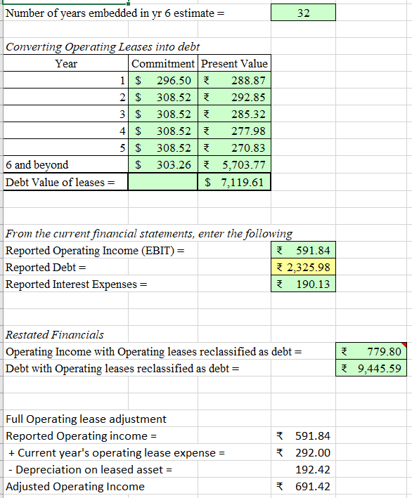
Firm Story
Adjustments

Slide 12

Projecting Cashflows
Growth Rate
Capex Rate
Non Cash Working Capital
 | 1-5 year | 5-6 year | Terminal year
Growth rate | 2.31% | 2.17% | 2.00%
Capex rate | 36% | 22% | 10%
Non cash working capital rate | -15% | -4% | 0%

Slide 13

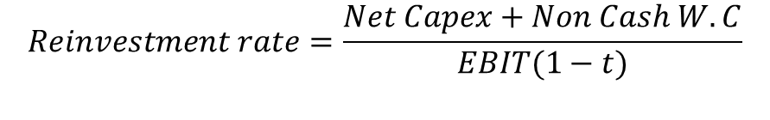
` | 2015 | 2016 | 2017 | 2018 | 2019
Capex | -311.13 | -398.62 | -393.96 | -504.94 | -460.39
Dep | 291.29 | 316.67 | 299.37 | 301.2 | 327.85
Net Capex | 19.84 | 81.95 | 94.59 | 203.74 | 132.54
EBIT | 648.91 | 348.1 | 354.41 | 453.33 | 591.84
tax rate | 34.94% | 34.94% | 34.94% | 34.94% | 34.94%
Net Capex as % of EBIT | 422.1808 | 226.4739 | 230.5791 | 294.9365 | 385.0511
Net Capex % of EBIT(1-t) | 5% | 36% | 41% | 69% | 34% | 37%
 | 2015 | 2016 | 2017 | 2018 | 2019
Total Current Assets | 1722.49 | 1121.65 | 926.34 | 1219.53 | 1150.35
Total Current Liabilities | 1432.26 | 2303.21 | 1839.27 | 1393.44 | 2089.46
working capital | 290.23 | -1181.56 | -912.93 | -173.91 | -939.11
Non Cash Current Assets | 477.28 | 510.23 | 430.81 | 494.56 | 534.62
Non Debt Current Liabilities | 1842.29 | 3179.36 | 1330.61 | 876.39 | 1410
Noncash working capital | -1365.01 | -2669.13 | -899.8 | -381.83 | -875.38
Revenue | 4188.64 | 4590.92 | 4010.26 | 4103.55 | 4512
Non cash wc % of revenue | -33% | -58% | -22% | -9% | -19% | -28%
$$Reinvestment rate=\frac{Net Capex+Non Cash W.C}{EBIT(1−t)}$$
$$ROC=\frac{EBIT\left(1−t\right)}{(Total Capital−Cash)}$$
$$EBIT Growth rate=Reinvestment rate∗ROC$$

Slide 14

Reinvestment Rate
Using sales to capital ratio:

Slide 15
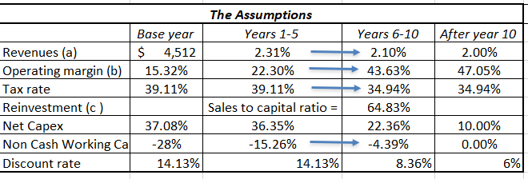
Assumptions

Slide 16

Discount rate
Cost of Equity
Cost of Debt
Cost
of
Capital

Slide 17



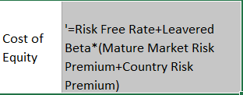
Risk free rate
Risk Premium
Beta
Equity
Cost
10 Yrs govt bond
Levered Beta
Country risk premium
Market Risk Premium

Slide 18

Risk Free Rate
Default Spread
Debt
Cost
10 Year Govt. Bond
Bond rating
AA[Stable]
Baa2

Slide 19
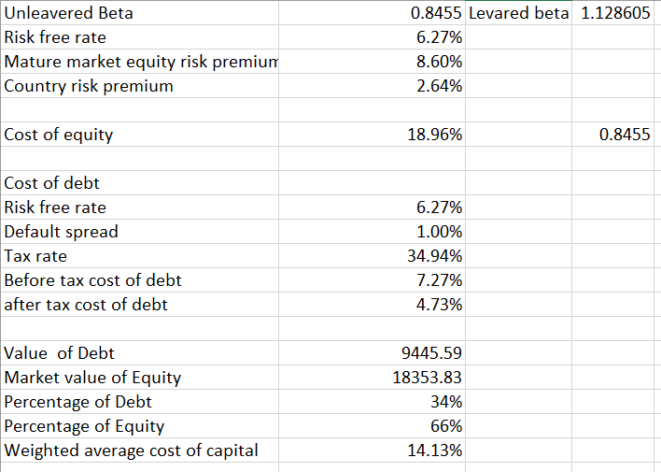
Cost of Capital

Slide 20
Capex & WC
Summary
Sale /Capital
Terminal value | ₹ 39,547.53 | Terminal value | ₹ 39,599.91
PV(Terminal value) | ₹ 13,716.51 | PV(Terminal value) | ₹ 13,734.67
PV (CF over next 10 years) | ₹ 6,676.33 | PV (CF over next 10 years) | ₹ 10,190.19
Sum of PV | ₹ 20,392.83 | Sum of PV | ₹ 23,924.87
Probability of failure = | 0% | Probability of failure = | 0%
Value of operating assets = | ₹ 20,392.83 | Value of operating assets = | ₹ 23,924.87
- Debt | ₹ 9,445.59 | - Debt | ₹ 9,445.59
- Minority interests | 799.86 | - Minority interests | ₹ 799.86
+ Cash | 452.15 | + Cash | ₹ 452.15
+ Non-operating assets | 455.43 | + Non-operating assets | ₹ 455.43
Value of equity | ₹ 11,054.96 | Value of equity | ₹ 14,586.99
- Value of options | 0 | - Value of options | 0
Value of equity in common stock | ₹ 11,054.96 | Value of equity in common stock | ₹ 14,586.99
Number of shares | 1189258445 | Number of shares | 1189258445
Estimated value /share | ₹ 92.96 | Estimated value /share | ₹ 122.66
Price | 154.33 | Price | 154.33
Price as % of value | ₹ 1.66 | Price as % of value | ₹ 1.26

